Slide 1
Capturing whole genome characteristics in short sequences using a Naive Bayesian classifier
Seminar 1
Data Mining
HKR
Hazrat Ali
Teacher: Dawit Mengistu
Notes:
So the topic is
Capturing whole genome characteristics in short sequences using a Naive Bayesian classifier
For this seminar.

Slide 2

Task
. Genome (DNA) information
. Genome of origin
Place
. Karolinska Institute (stk)
. Publisher : cold spring harbor lab
Notes:
By
Rickard , Gösta Winberg,
At
Karolinska Institute, S-171 77 Stockholm, Sweden
Which is a leading research institute and medical university at Scandinavia

Slide 3
Related work
. The complete Genome
. Recent studies investigated
. Comparative studies identified bio
features like , oligo, di,
Tetranucleotides.
. Motifs of different lengths,
- Which led to identify different
signatures.
Notes:
The complete Genome known already
Recent studies investigated subsets of proteins
Comparative studies identified bio features like , oligo, di, tetranucleotides.
These studies used motifs of different lengths, which led to identify different signatures.

Slide 4
Research Question
. Identify the genome of origin for a given sequence using
the genomic signature concept
. Use Naive Bayesian technique
Notes:
The first step in research execution is to state clearly what is the research article covering
Or
What is the research question
The research question of the article is to identify the genome of origin for a given genome sequence
The article is using naive bayesian classifier
Because it is commonly used in text classification

Slide 5
Method
Genome Scan
Choose random genome sequence
Extract motifs
Naive Bayesian classifier
Data ?
Notes:
Method or methodology used to find the answer to the reseach question.
This method in this article simply use a few steps.
1. All genomes are scanned for the occurrences of overlapping motifs with a length of n nucleotides (4^n)
2. Choose a random genomic sequence from anywhere inside a genome
3. From the genomic sequence motifs are extracted
4. Use NB classifier to predict the most probable genomic origin. By comparing the extracted motifs with the known motifs of different genomes.
Data:
5. data:
The complete genomic sequence of 28 archae and eubacte-
rium organisms, with genome sizes ranging from 580 kb for
Mycoplasma genitalia to 4.639 kb for Escherichia coli, were ob-
tained from GenBank and TIGR at 05/00.
6. scanned 8 to 9 nucleotids

Slide 6
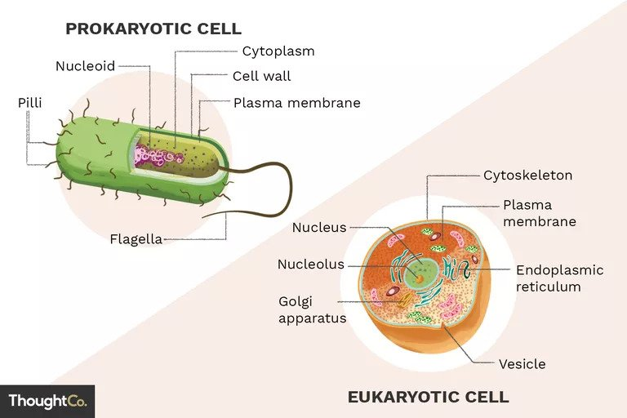
BIO
Prokaryotic
are those organisms whose cells lack a nucleus eg. bacteria.
Eukaryotic
are those organisms whose cells possess a membrane bounded nucleus.
Genome - a set of chromosomes
Nucleotides are the basic building blocks of DNA and RNA
Gene transfer: vertical, horizontal
H Influenza, N Meningitis: Bacteria causing infections
Notes:
Trust me we need some bio to understand this article :)
Prokaryotic
are those organisms whose cells lack a nucleus eg. bacteria.
Eukaryotic
are those organisms whose cells possess a membrane bounded nucleus.
Genome - a set of chromosomes
Nucleotides are the basic building blocks of DNA and RNA
In other words these are units for forming nucleic acid polymers deoxyribonucleic acid (DNA) and ribonucleic acid RNA
DNA, RNA are the essential biomolecules within all living things on the earth.
. The transfer of genetic information from parents to children is called vertical gene transfers.
. The transfer of genetic information by bacteria, virus, plasmids is termed as horizontal gene transfer.
This article has used horizontal gene transfer.
. H Influenza, N meningitis: are bacteria which causes respiratory infections and other infections

Slide 7
Findings
Some generalization
BN performance depends on sequence and motif length
Identified horizontal gene transfer
H. Influenza to N Meningitis i.
Notes:
After doing this research they did some generalization of the sequences and motifs
And found that
The more we increase the more accuracy we get
They identified the horizontal gene transfer
H. Influenza to N Meningitis is the best documented case available for horizontal gene transfer n therefore used as a reference.

Slide 8
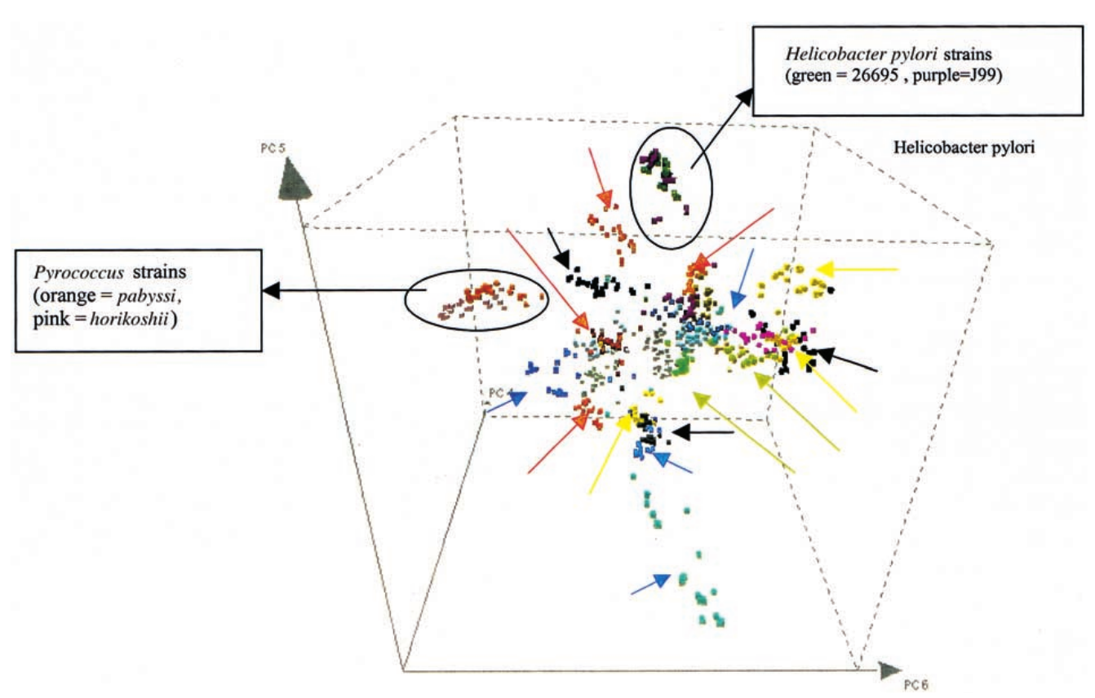
Results
. Did principal component
analysis
. Visualize the difference
in motif frequencies
between genomes
of prokaryotic species
Notes:
Principal component analysis or PCA is the collection of attributes and then do analysis.
These are not linearly correlated attributes set.
This is Visualizing the Genomic Signature Concept.
Which visualizes the difference in motif frequencies between and within the genomes of prokaryotic species
. Different eubacterial and archaeal genomes form clusters in the three-dimensional space

Slide 9
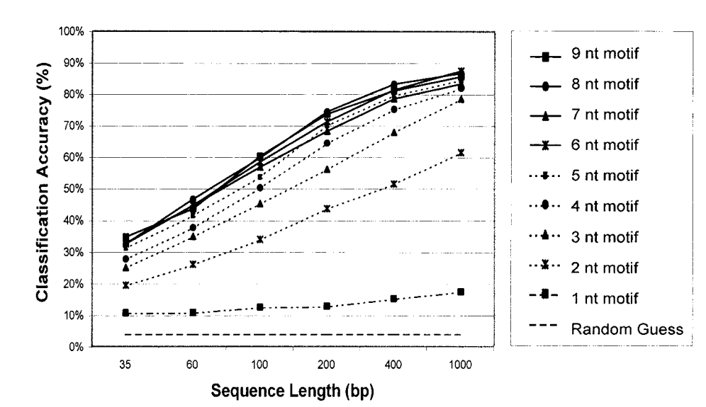
Results
Dependance of classification accuracy on motifs and sequence length
Performance depends on length - for genomic signature
Training 90% , 10% for testing
Longer motifs result in specific representation.
Different lengths of sequences
Notes:
Dependance of classification accuracy on motifs and sequence length
Performance depends on length - for genomic signature
Training 90% of genomic sequence. 10% for testing
Longer motifs result in specific representation.
6 different lengths of sequences as shown - highest accuracy with 8,9 motifs

Slide 10
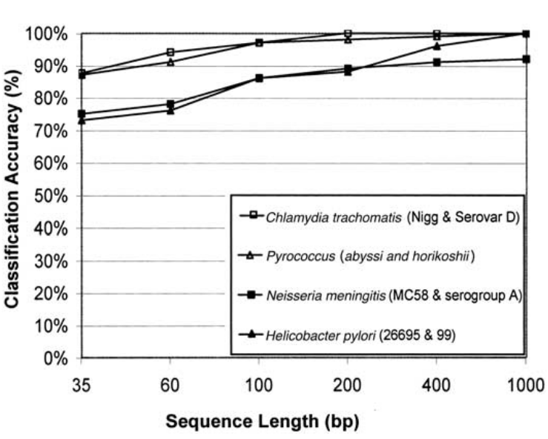
Results
Classification of closely related microorganisms.
Accuracy
Classified as :
Chlamydia, Pyrococcus, NMeningitis, H Pylori
Notes:
Classification of closely related microorganisms.
Accuracy between different strains of same species
Classified as :
Chlamydia, Pyrococcus, NMeningitis, H Pylori

Slide 11
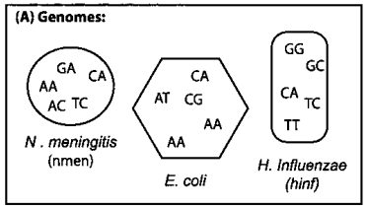
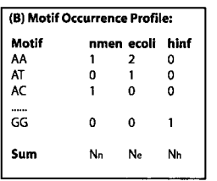
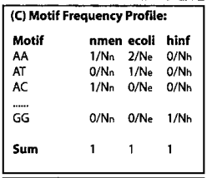
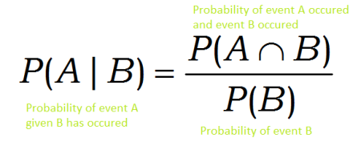
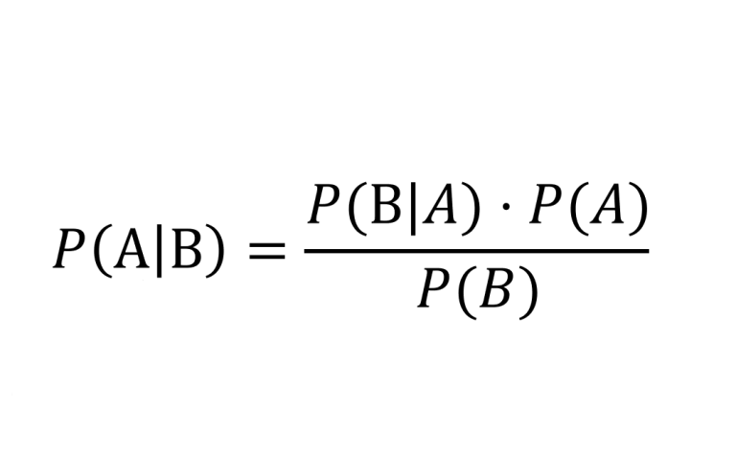
Naive Bayesian classifier
. Conditional probabilities .ie if B then how likely A ?
Conditional probability
Notes:
Naive Bayesian classifier
. conditional probabilities .ie if A then how likely B ?
.

Slide 12

Naive Bayesian classifier
. Conditional probabilities .ie if B then how likely A?
Classifier
Notes:
The ordered set of nucleotides in each bacterial genome analyzed is referred to as a “class”
. they trained classifier using specific genome sequences to distinguish between classes
. given sequence S, probability of the sequence to belong to a certain genome Gi, we can model it a shown in formula
. The aim of the classifier is, given a sequence S, to predict its most probable genomic origin

Slide 13
Conclusion
HG transfer
. Successfully classify genomic sequences
. 400 nucleotides from 25 bacteria > 85% accuracy
. Partial sequences - provided best results with 8,9 nt motifs
. longer sequences
. Horizontal gene transfer
Notes:
So the article
Successfully classify genomic sequences by motif frequency distributions
. 400 nucleotides from 25 bacteria > 85% accuracy
. Applied the classifier to partial sequences - provided best results with 8,9 nucleatides motifs
. longer sequences permit a more specific motif representation
. horizontal gene transfer - identification of horizontal gene transfer events in the Neisseria men-
ingitis genome, H Inluenza
It is also interesting to speculate whether this method
could be applied to analyze complex mixtures such as water, soil etc.

Slide 14
Questions ?
Thanks

